Slide 1
Barnes Hut Simulation for N-body simulations
Samyak Jain & Nihar Dwivedi

Slide 2
What is N-body simulation?
An N-body simulation approximates the motion of particles, often specifically particles that interact with one another through some type of physical forces (like gravity, atomic forces, etc. )
In a basic N-body simulation every body exerts force on every other body in the system. This means that in every step of the simulation a net force from all the other bodies has to be computed for each of the bodies
The complexity of this is O(n^2) where n is the number of particles. This means that this is not practically possible for simulations with large number of particles
Different methods used:
Barnes-Hut algorithm
Fast multipole method
parallel tree multipole algorithm
We explore the Barnes Hut algorithm in this project

Slide 3
Barnes Hut Simulation
The Barnes Hut simulation is an approximation algorithm for performing an n body simulation.
It has a time complexity of O(nlogn) in comparison with O(n^2) of direct sum algorithm.
The simulation volume is usually divided up into cubic cells via an octree (in a three-dimensional space), or a quadtree(in a two dimensional space) so that only particles from nearby cells need to be treated individually, and particles in distant cells can be treated as a single large particle centered at the cell's center of mass (or as a low-order multipole expansion).
This can dramatically reduce the number of particle pair interactions that must be computed.

Slide 4
Barnes Hut Simulation
The force on each particle can be given by the general equation:
force = external_force + nearest_neighbor_force + far_field_force
In a lot of n-body simulations, the external forces on each particle/body can be computed for each particle independently, in an embarrassingly parallel way
This reduces the complexity to O(n*logn)
This algorithm is serial, with further speedups possible through parallelization

Slide 5
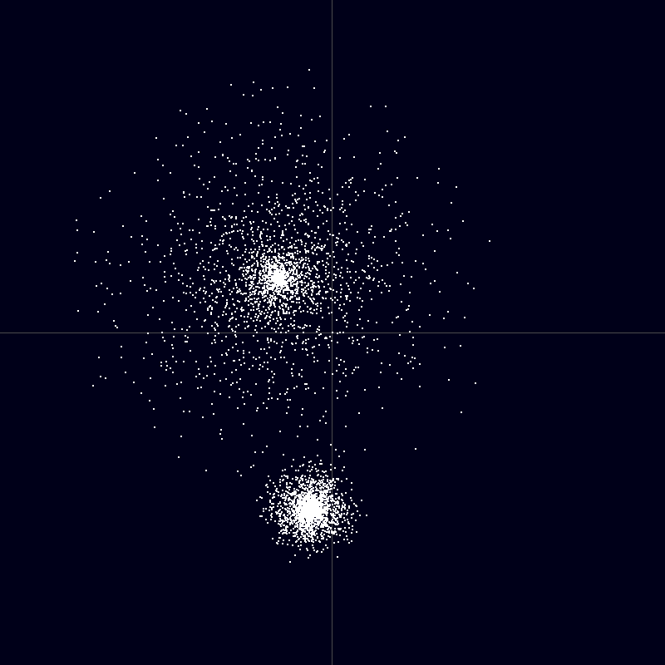
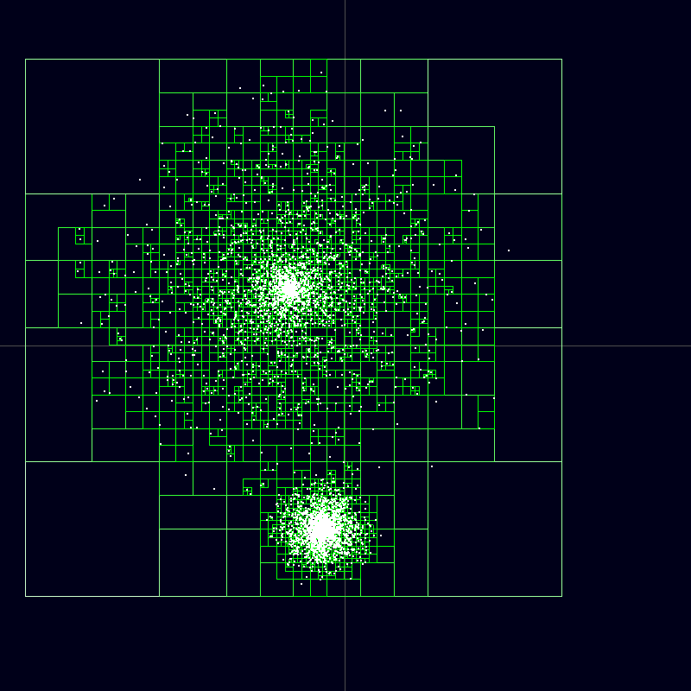
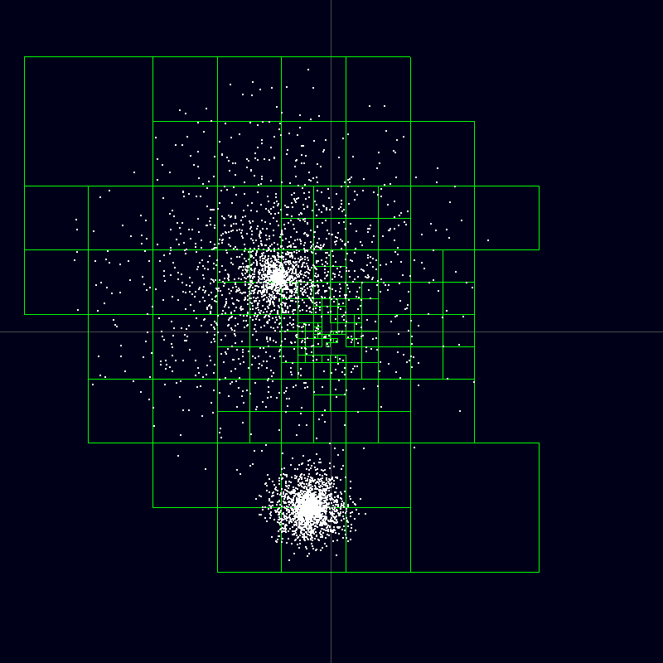
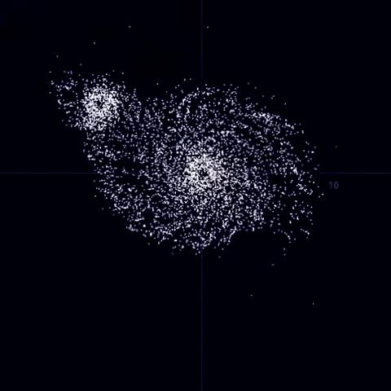
Sample Calculation
Particle distribution resembling two neighboring galaxies.
Complete Barnes–Hut tree. (Nodes that do not contain particles are not drawn)
Nodes of the Barnes–Hut tree used for calculating the force acting on a particle at the point of origin.
n-Body simulation based on the Barnes–Hut algorithm.

Slide 6
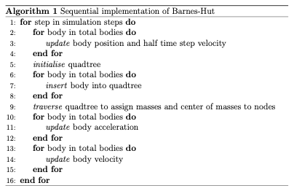
Pseudo Code for the Algorithm

Slide 7
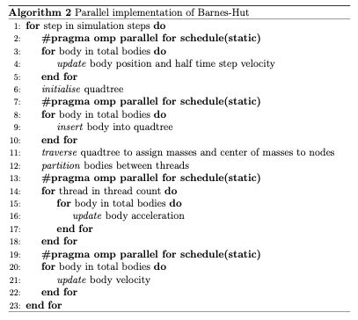
Pseudo Code for the Algorithm

Slide 8
Challenges
The algorithms presents a few challenges that need to be overcome for successful parallelization
The cost of building and traversing a quad-tree can increase signiﬁcantly when divided among processes.
Traversing a quad-tree can increase signiﬁcantly when divided among processes.
The irregularly structured and adaptive nature of the algorithm makes the data access patterns dynamic and irregular, and the nodes essential to a body cannot be computed without traversing the quad-tree.
Building a quad-tree needs synchronization.
The value of the ﬁxed accuracy parameter (θ) plays a prominent role and must be optimized. Higher values of θ imply that fewer nodes are considered in the force computation thus increasing the window for error; while lower values of θ will bring the Barnes-Hut approximation time complexity closer to that of the AllPairs algorithm.

Slide 9
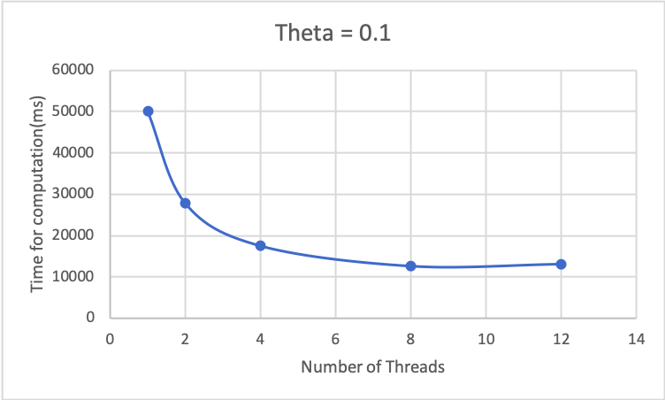
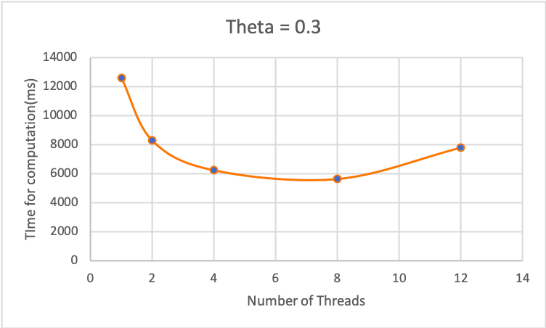
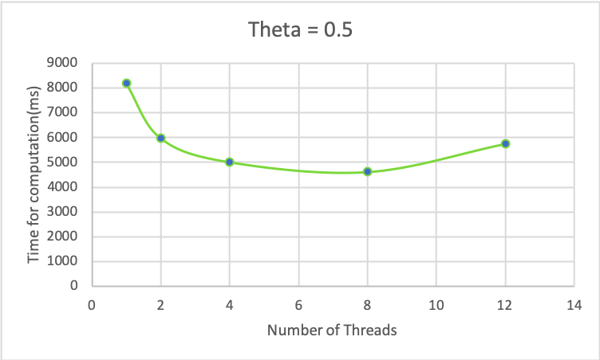
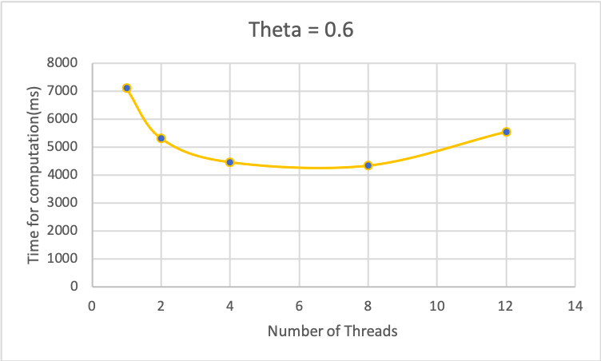
Results

Slide 10
References
http://physics.princeton.edu/~fpretori/Nbody/intro.htm
http://www.cs.cmu.edu/~guyb/real-world/nbody/index.html
http://arborjs.org/docs/barnes-hut
https://beltoforion.de/article.php?a=barnes-hut-galaxy-simulator
https://jheer.github.io/barnes-hut/

